Slide 1
Quantum Basics

Slide 2
Features that differentiates Quantum Computers
Interference Effect
Superposition
Entanglement

Slide 3
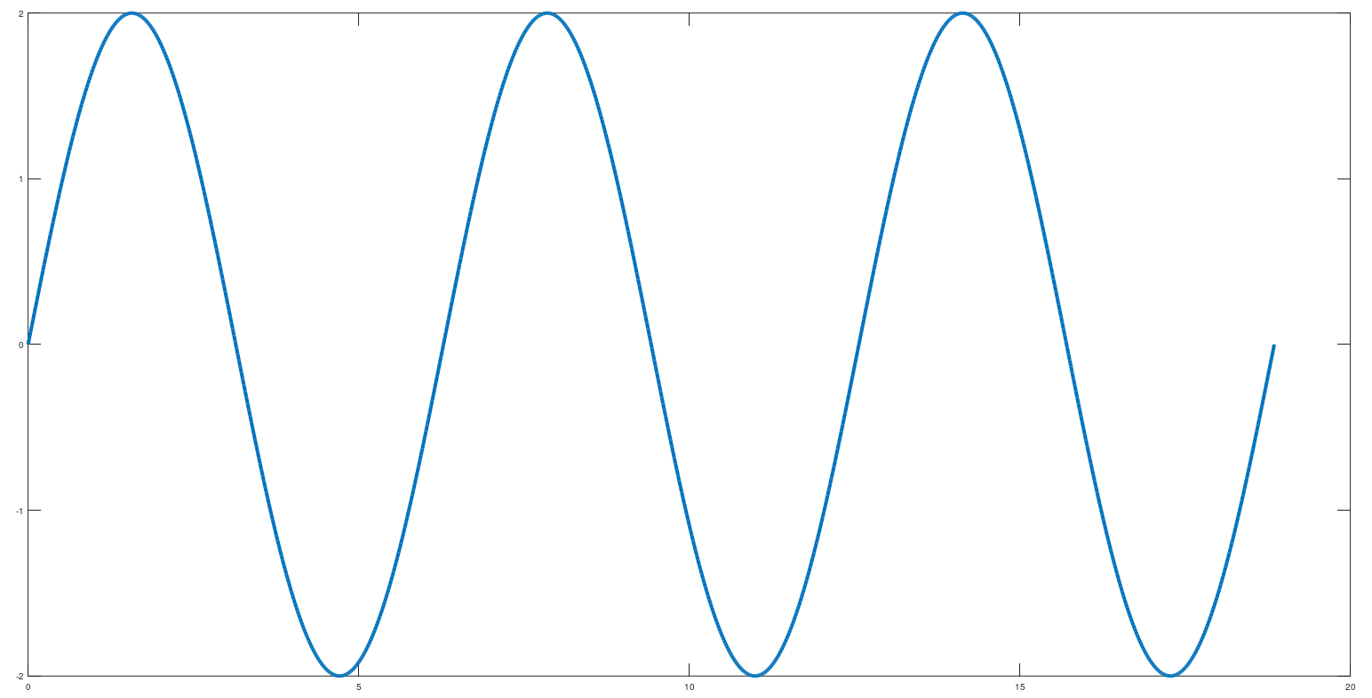
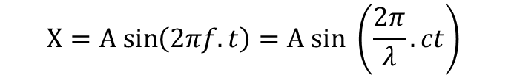
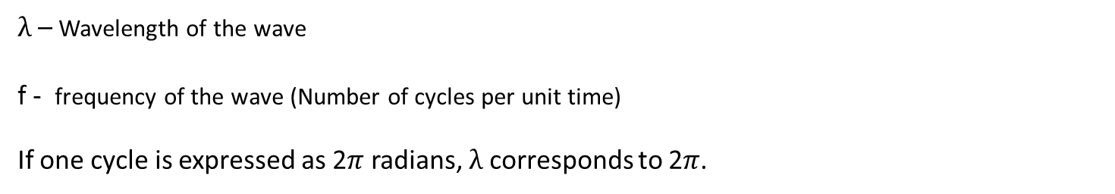

Waves
$λ (2π radians)$
A
-A
$$X=A sin\left(2πf.t\right)=A sin \left(\frac{2π}{λ}.ct\right)$$
$λ$ – Wavelength of the wave
f - frequency of the wave (Number of cycles per unit time)
If one cycle is expressed as 2$π$ radians, $λ$ corresponds to 2$π$.

Slide 4
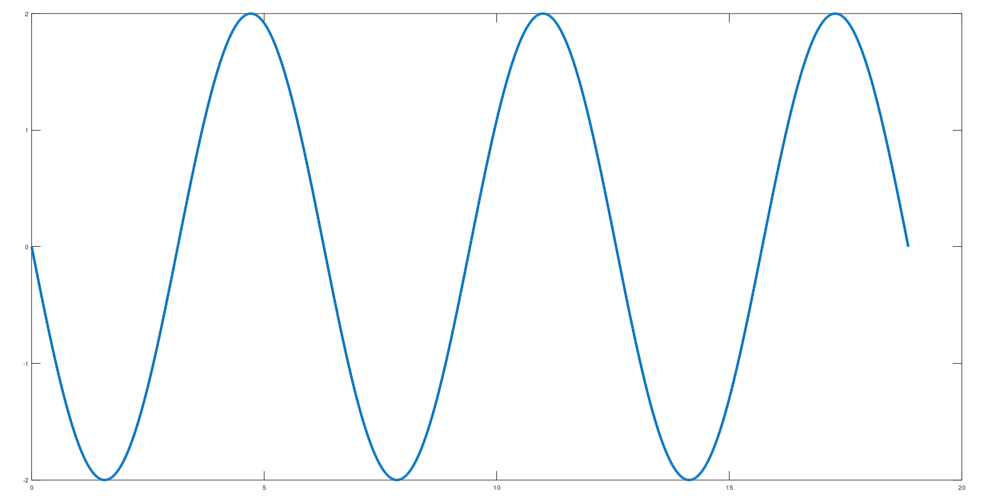
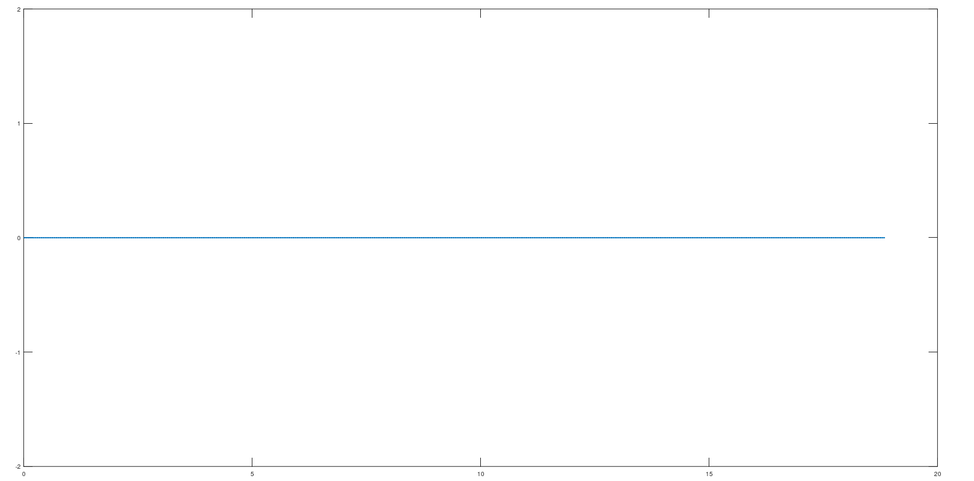


Destructive Interference
$$X1=A sin{θ }$$
A
$$X1+X2=2A\sin{(θ+\frac{π}{2})}\cos{(\frac{π}{2})}=0$$
-A
+
$$X2=A sin\left(θ+π\right)$$
A
-A

Slide 5
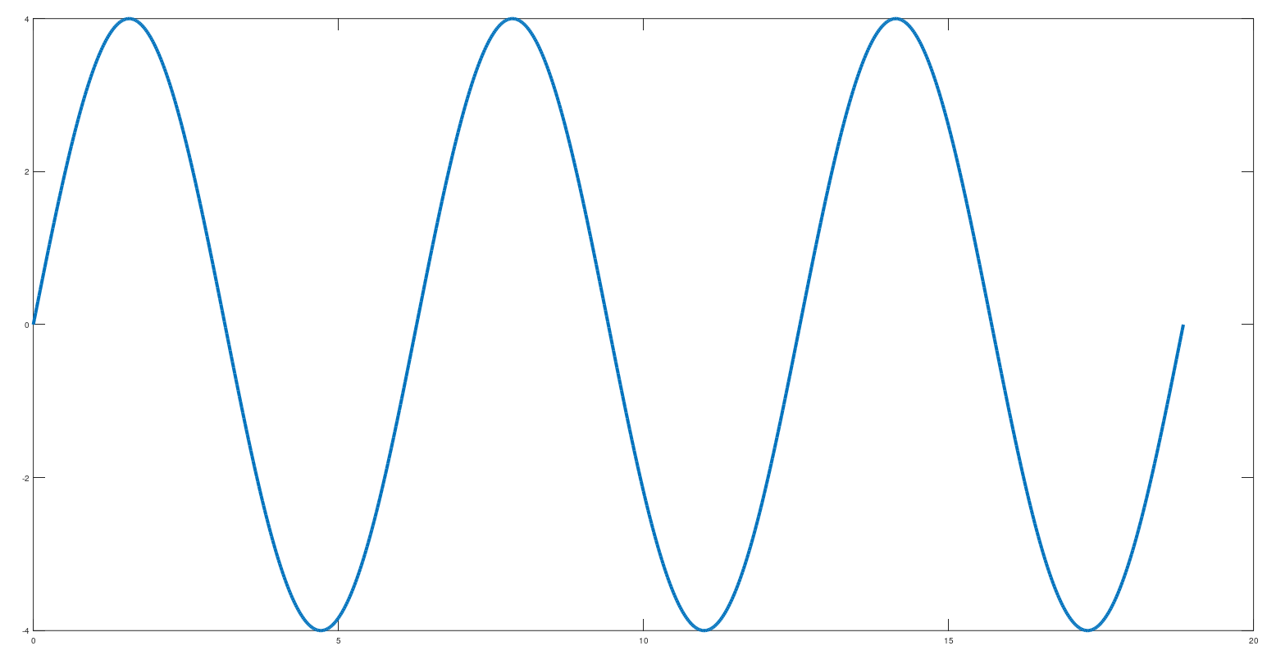


Constructive Interference
$$X1=A sin{θ }$$
A
$$X1+X2=2A\sin{(θ+π)}\cos{(π)}=2A sin θ$$
2A
-A
+
$$X1=A sin{(θ+2π)}$$
A
-2A
-A

Slide 6




Mathematical Treatment (Classical view)
P1
What is the probability of a particle reaching P1?
$$p11$$
$$p1$$
S1
$$p21$$
The gun fires one particle at a time.
P2
Electron gun
$$p2$$
S2
P3
Classically the probability of a particle reaching P1 = $p1. p11+p2. p21$

Slide 7

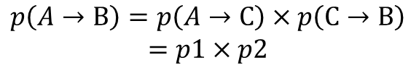




Concept of Probabilities and Probability Amplitudes
In classical probability theory, probabilities have the following rules.
B
$$p1$$
$$p\left(A→B\right)=p1+p2$$
For mutually exclusive events, probabilities add.
$p$2
A
$p$2
B
For events that successively follow, probabilities multiply.
C
$$p1$$
A
$$p\left(A→B\right)=p\left(A→C\right)×p\left(C→B\right)$$
$$=p1×p2$$

Slide 8
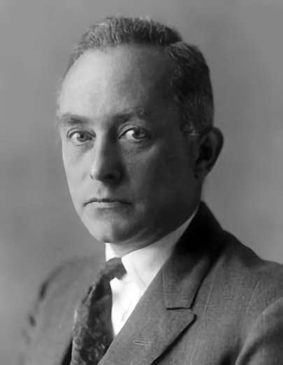



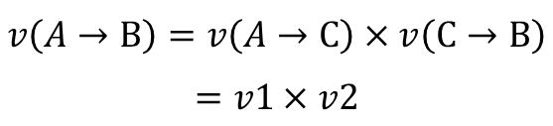





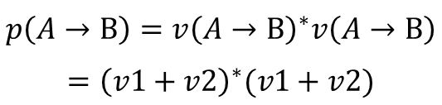
Concept of Probabilities and Probability Amplitudes
In quantum mechanics we use probability amplitudes instead of probabilities.
Probability amplitudes are complex numbers. They have an amplitude and a phase.
$$v= \left|v\right|e^{iθ}$$
Probability amplitudes and probabilities are connected in the following way.
$$p=v^{∗}v={\left|v\right|}^{2}$$
Max Born
Source - Max Born - Wikipedia
Probability amplitudes follow the same principles as probabilities.
B
$$v1$$
$$v\left(A→B\right)=v1+v2$$
For mutually exclusive events, probability amplitudes add.
$$p\left(A→B\right)=v{\left(A→B\right)}^{∗}v\left(A→B\right)$$
$$={\left(v1+v2\right)}^{∗}(v1+v2)$$
$v$2
$$p\left(A→B\right)={\left|v1\right|}^{2}+{\left|v2\right|}^{2}+v1^{∗}v2+v2^{∗}v1$$
A
$v$2
B
For events that successively follow, probability amplitudes multiply.
$$v\left(A→B\right)=v\left(A→C\right)×v\left(C→B\right)$$
$$=v1×v2$$
C
$$p\left(A→B\right)=v{\left(A→B\right)}^{∗}v\left(A→B\right)={\left|v1\right|}^{2}{\left|v2\right|}^{2}$$
$$v1$$
$${=\left|v1\right|\left|v2\right|e}^{i(θ_{1}+θ_{2})}$$
A

Slide 9





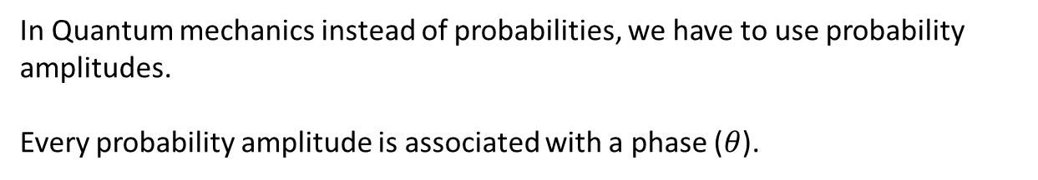







Mathematical Treatment (Quantum view)
P1
$$v1= \left|v1\right|e^{iθ_{1}}$$
$$v11$$
$$p1=v1^{∗}v1={\left|v1\right|}^{2}$$
$$v1$$
S1
$$v21$$
$$v2= \left|v2\right|e^{iθ_{2}}$$
$$p2=v2^{∗}v2={\left|v2\right|}^{2}$$
P2
Electron gun
$$v11= \left|v11\right|e^{iθ_{11}}$$
$$v2$$
$$p11=v11^{∗}v11={\left|v11\right|}^{2}$$
S2
P3
$$v21= \left|v21\right|e^{iθ_{21}}$$
$$p21=v21^{∗}v21={\left|v21\right|}^{2}$$
In Quantum mechanics instead of probabilities, we have to use probability amplitudes.
Every probability amplitude is associated with a phase ($θ$).

Slide 10
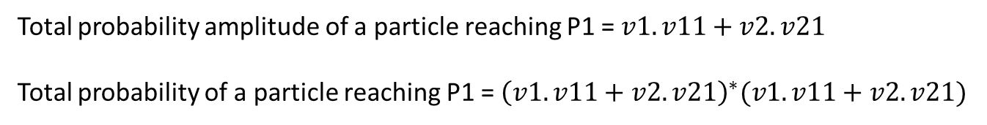
Mathematical Treatment (Quantum view)
P1
$$v11$$
$$v1$$
S1
$$v21$$
P2
Electron gun
$$v2$$
S2
P3
Total probability amplitude of a particle reaching P1 = $v1. v11+v2. v21$
Total probability of a particle reaching P1 = ${\left(v1. v11+v2. v21\right)}^{∗}(v1. v11+v2. v21)$

Slide 11


Mathematical Treatment (Quantum view)
Total probability of a particle reaching P1 = ${\left(v1. v11+v2. v21\right)}^{∗}(v1. v11+v2. v21)$
$$={\left|v1\right|}^{2}{\left|v11\right|}^{2}+{\left|v2\right|}^{2}{\left|v21\right|}^{2}+v1^{∗}v{11}^{∗}v2. v21+v2^{∗}v{21}^{∗}v1. v11$$
$$=p1.p11+p2.p21+\left|v1\right|e^{−iθ_{1}}\left|v11\right|e^{−iθ_{11}}\left|v2\right|e^{iθ_{2}}\left|v21\right|e^{iθ_{21}}+\left|v2\right|e^{−iθ_{2}}\left|v21\right|e^{−iθ_{21}}\left|v1\right|e^{iθ_{1}}\left|v11\right|e^{iθ_{11}}$$
$$=p1.p11+p2.p21+\left|v1\right|\left|v11\right|{\left|v2\right|\left|v21\right| (e}^{i[\left(θ_{2}+θ_{21}\right)−\left(θ_{1}+θ_{11}\right)]}+e^{−i[\left(θ_{2}+θ_{21}\right)−\left(θ_{1}+θ_{11}\right)]})$$
$=p1.p11+p2.p21+2$ $\sqrt{p1.p11.p2.p21} \cos{\{\left(θ_{2}+θ_{21}\right)−\left(θ_{1}+θ_{11}\right)\}}$
Phase while passing through S2 = $θ_{2}+θ_{21}=θ_{s2}$
Phase while passing through S1 = $θ_{1}+θ_{11}=θ_{s1}$
Total probability of a particle reaching P1 = $p1.p11+p2.p21+2$ $\sqrt{p1.p11.p2.p21} \cos{(θ_{s2}−θ_{s1})}$
Maximum total probability = $p1.p11+p2.p21+2$ $\sqrt{p1.p11.p2.p21}$
$$(\cos\left(θ_{s2}−θ_{s1}\right)=1)$$
Minimum total probability = $p1.p11+p2.p21−2$ $\sqrt{p1.p11.p2.p21}$ $(\cos\left(θ_{s2}−θ_{s1}\right)=−1)$

Slide 12







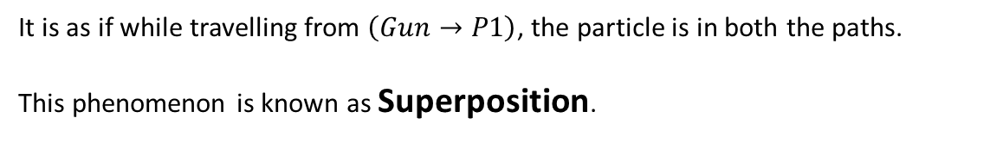
Classical vs Quantum
The total probability in the Quantum view could be higher or lower than the total probability in the classical view.
The difference between the classical and quantum probabilities is entirely controlled by the phases of the probability amplitudes.
Classical
Quantum
Interference term
$$P_{C}=p1. p11+p2. p21$$
$P_{Q}=p1.p11+p2.p21+2$ $\sqrt{p1.p11.p2.p21} \cos{(θ_{s2}−θ_{s1})}$
P1
P1
$p$11
S1
S1
$$p1$$
S2
$$p2$$
S2
$$p21$$
In Quantum, we cannot distinguish between the path probabilities.
Gun
Gun
$P\left(Gun→S1→P1\right)=p1 . p11$
$$P\left(Gun→S1→P1\right)=f_{1}\left(Gun→S1→P1\right)+ f_{2}\left(Gun→S2→P1\right)$$
$P\left(Gun→S2→P1\right)=p2 . p21$
$$P\left(Gun→S2→P1\right)=f_{1}\left(Gun→S2→P1\right)+ f_{2}\left(Gun→S1→P1\right)$$
$$P_{C}=P\left(Gun→S1→P1\right)+P\left(Gun→S2→P1\right)$$
It is as if while travelling from $\left(Gun→P1\right)$, the particle is in both the paths.
This phenomenon is known as Superposition.

Slide 13

















Expressing Superposition
The particle is either going through slit S1 or through slit S2.
$$p1+p2=1$$
$$P\left(Gun→S1\right)=p1$$
Superposition State
$$\left[\begin{matrix}1 \\ 0\end{matrix}\right]$$
$$P\left(Gun→S2\right)=p2$$
$$v1$$
S1
$$v1 Path A+v2 Path B$$
$$V\left(Gun→S1\right)=v1$$
$${\left|v1\right|}^{2}+{\left|v2\right|}^{2}=1$$
$$V\left(Gun→S2\right)=v2$$
In vector form
Electron gun
$${p1= \left|v1\right|}^{2}$$
$$\left[\begin{matrix}0 \\ 1\end{matrix}\right]$$
$$v2$$
$$Path A=\left[\begin{matrix}1 \\ 0\end{matrix}\right]$$
$$Path B =\left[\begin{matrix}0 \\ 1\end{matrix}\right]$$
$${p2= \left|v2\right|}^{2}$$
S2
$$v1\left[\begin{matrix}1 \\ 0\end{matrix}\right]+v2\left[\begin{matrix}0 \\ 1\end{matrix}\right]$$
Measurement results in breaking of the superposition state and the particle manifests in one of the paths.

Slide 14
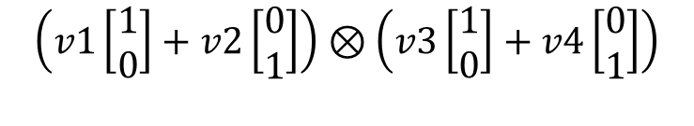






Two Particle System
Vector expression
Path A
S1
$$\left[\begin{matrix}1 \\ 0 \\ \begin{matrix}0 \\ 0\end{matrix}\end{matrix}\right]$$
Path A
Path A
Electron gun
Path B
$$\left[\begin{matrix}0 \\ 1 \\ \begin{matrix}0 \\ 0\end{matrix}\end{matrix}\right]$$
Path A
Path B
S2
Superposition states of each particle
$$v1\left[\begin{matrix}1 \\ 0\end{matrix}\right]+v2\left[\begin{matrix}0 \\ 1\end{matrix}\right]$$
$$\left[\begin{matrix}0 \\ 0 \\ \begin{matrix}1 \\ 0\end{matrix}\end{matrix}\right]$$
Path B
Path A
$$v3\left[\begin{matrix}1 \\ 0\end{matrix}\right]+v4\left[\begin{matrix}0 \\ 1\end{matrix}\right]$$
$$\left[\begin{matrix}0 \\ 0 \\ \begin{matrix}0 \\ 1\end{matrix}\end{matrix}\right]$$
Combined state (Product state)
Path B
Path B
$$\left(v1\left[\begin{matrix}1 \\ 0\end{matrix}\right]+v2\left[\begin{matrix}0 \\ 1\end{matrix}\right]\right)⊗\left(v3\left[\begin{matrix}1 \\ 0\end{matrix}\right]+v4\left[\begin{matrix}0 \\ 1\end{matrix}\right]\right)$$

Slide 15
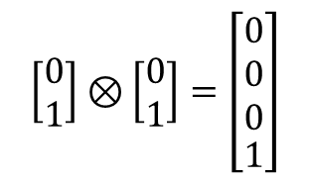

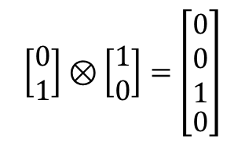

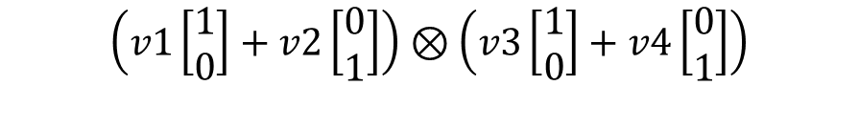
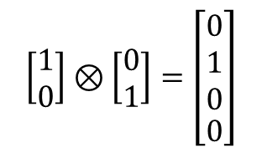

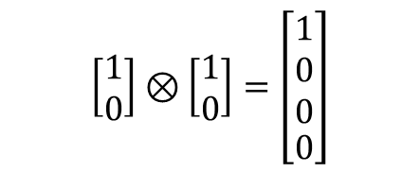

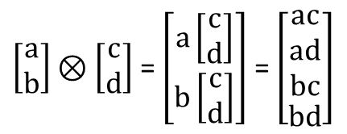

Two Particle System (Optional)
$$\left(v1\left[\begin{matrix}1 \\ 0\end{matrix}\right]+v2\left[\begin{matrix}0 \\ 1\end{matrix}\right]\right)⊗\left(v3\left[\begin{matrix}1 \\ 0\end{matrix}\right]+v4\left[\begin{matrix}0 \\ 1\end{matrix}\right]\right)$$
$$⊗− Kronecker Product$$
$=v1.v3\left[\begin{matrix}1 \\ 0\end{matrix}\right]⊗$ $\left[\begin{matrix}1 \\ 0\end{matrix}\right]+ v1.v4\left[\begin{matrix}1 \\ 0\end{matrix}\right]⊗$ $\left[\begin{matrix}0 \\ 1\end{matrix}\right]+v2.v3\left[\begin{matrix}0 \\ 1\end{matrix}\right]⊗ \left[\begin{matrix}1 \\ 0\end{matrix}\right]+v2.v4\left[\begin{matrix}0 \\ 1\end{matrix}\right]⊗ \left[\begin{matrix}0 \\ 1\end{matrix}\right]$
Path A, Path A
Path A, Path B
Path B, Path A
Path B, Path B
$$\left[\begin{matrix}1 \\ 0 \\ \begin{matrix}0 \\ 0\end{matrix}\end{matrix}\right]$$
$$\left[\begin{matrix}0 \\ 1 \\ \begin{matrix}0 \\ 0\end{matrix}\end{matrix}\right]$$
$$\left[\begin{matrix}0 \\ 0 \\ \begin{matrix}1 \\ 0\end{matrix}\end{matrix}\right]$$
$$\left[\begin{matrix}0 \\ 0 \\ \begin{matrix}0 \\ 1\end{matrix}\end{matrix}\right]$$
$\left[\begin{matrix}a \\ b\end{matrix}\right]⊗\left[\begin{matrix}c \\ d\end{matrix}\right]$ = $\left[\begin{matrix}a\left[\begin{matrix}c \\ d\end{matrix}\right] \\ b\left[\begin{matrix}c \\ d\end{matrix}\right]\end{matrix}\right]$ = $\left[\begin{aligned}\begin{matrix}ac \\ ad \\ bc\end{matrix} \\ bd\end{aligned}\right]$
$$\left[\begin{matrix}1 \\ 0\end{matrix}\right]⊗\left[\begin{matrix}1 \\ 0\end{matrix}\right]=\left[\begin{aligned}\begin{matrix}1 \\ 0 \\ 0\end{matrix} \\ 0\end{aligned}\right]$$
$$\left[\begin{matrix}1 \\ 0\end{matrix}\right]⊗\left[\begin{matrix}0 \\ 1\end{matrix}\right]=\left[\begin{aligned}\begin{matrix}0 \\ 1 \\ 0\end{matrix} \\ 0\end{aligned}\right]$$
$$\left[\begin{matrix}0 \\ 1\end{matrix}\right]⊗\left[\begin{matrix}1 \\ 0\end{matrix}\right]=\left[\begin{aligned}\begin{matrix}0 \\ 0 \\ 1\end{matrix} \\ 0\end{aligned}\right]$$
$$\left[\begin{matrix}0 \\ 1\end{matrix}\right]⊗\left[\begin{matrix}0 \\ 1\end{matrix}\right]=\left[\begin{aligned}\begin{matrix}0 \\ 0 \\ 0\end{matrix} \\ 1\end{aligned}\right]$$

Slide 16

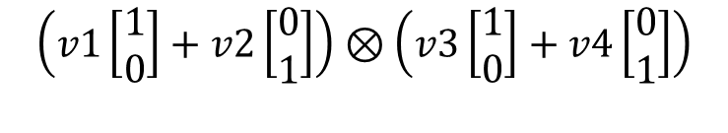
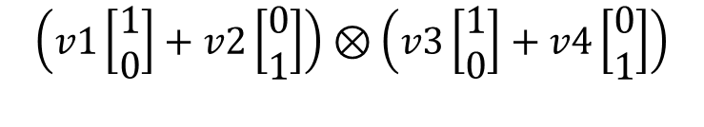


Entanglement of two particles
Under certain situations in a multi-particle system, it is not possible to express the superposition state of one particle.
The superposition state of only the combined system can be expressed.
When this happens, we say that the particles are entangled.
Product state
Entangled state
$$\left(v1\left[\begin{matrix}1 \\ 0\end{matrix}\right]+v2\left[\begin{matrix}0 \\ 1\end{matrix}\right]\right)⊗\left(v3\left[\begin{matrix}1 \\ 0\end{matrix}\right]+v4\left[\begin{matrix}0 \\ 1\end{matrix}\right]\right)$$
$$\left(v1\left[\begin{matrix}1 \\ 0\end{matrix}\right]+v2\left[\begin{matrix}0 \\ 1\end{matrix}\right]\right)⊗\left(v3\left[\begin{matrix}1 \\ 0\end{matrix}\right]+v4\left[\begin{matrix}0 \\ 1\end{matrix}\right]\right)$$
Entangled state can only be expressed in the following ways.
(i)
$$v1\left[\begin{matrix}1 \\ 0\end{matrix}\right] ⊗v3\left[\begin{matrix}1 \\ 0\end{matrix}\right]+v2\left[\begin{matrix}0 \\ 1\end{matrix}\right] ⊗v4\left[\begin{matrix}0 \\ 1\end{matrix}\right]$$
(ii)
$$v1\left[\begin{matrix}1 \\ 0\end{matrix}\right] ⊗v3\left[\begin{matrix}0 \\ 1\end{matrix}\right]+v2\left[\begin{matrix}0 \\ 1\end{matrix}\right] ⊗v4\left[\begin{matrix}1 \\ 0\end{matrix}\right]$$

Slide 17


What does that mean?
When measured, both particle will be either seen in Path A or Path B
S1
$$v1\left[\begin{matrix}1 \\ 0\end{matrix}\right] ⊗v3\left[\begin{matrix}1 \\ 0\end{matrix}\right]+v2\left[\begin{matrix}0 \\ 1\end{matrix}\right] ⊗v4\left[\begin{matrix}0 \\ 1\end{matrix}\right]$$
Electron gun
Or
S2
When measured, if is found in Path A, then for sure will be found in Path B and vice-versa.
$$v1\left[\begin{matrix}1 \\ 0\end{matrix}\right] ⊗v3\left[\begin{matrix}0 \\ 1\end{matrix}\right]+v2\left[\begin{matrix}0 \\ 1\end{matrix}\right] ⊗v4\left[\begin{matrix}1 \\ 0\end{matrix}\right]$$

Slide 18


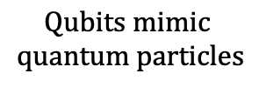




How do we use these properties in Quantum computing
Constructive
Interference
P1
$$v11$$
$$Qubits mimic$$
$$quantum particles$$
P1
$$v1$$
S1
$$v21$$
$$Measurement$$
P2
$$v12$$
Electron gun
$$v2$$
$$v22$$
Destructive
Interference
S2
P3
P2
$$v13$$
$$v23$$
P3
$$Quantum circuits mimic the path the particle takes$$

Slide 19





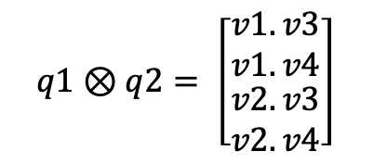

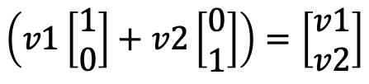
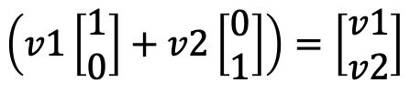





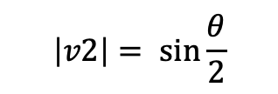

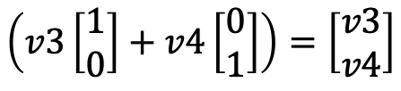


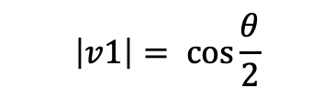
Representation of qubit states
$$\left(v1\left[\begin{matrix}1 \\ 0\end{matrix}\right]+v2\left[\begin{matrix}0 \\ 1\end{matrix}\right]\right)=\left[\begin{matrix}v1 \\ v2\end{matrix}\right]$$
$$\left|q1\right\rangle =v1\left|0\right\rangle +v2\left|1\right\rangle$$
$${\left|v1\right|}^{2}+{\left|v1\right|}^{2}=1$$
$$q1$$
$$v1= \left|v1\right|e^{iλ_{1}}$$
$$\left|q1\right\rangle =\left|v1\right|e^{iλ_{1}}\left|0\right\rangle +\left|v2\right|e^{iλ_{2}}\left|1\right\rangle$$
$$\left|0\right\rangle =\left[\begin{matrix}1 \\ 0\end{matrix}\right] \left|1\right\rangle =\left[\begin{matrix}0 \\ 1\end{matrix}\right]$$
$$v2= \left|v2\right|e^{iλ_{2}}$$
global phase
relative phase
$$\left|v1\right|= \cos{\frac{θ}{2}}$$
$${(λ}_{2}−λ_{1})=φ$$
$$\left|q1\right\rangle =\left|v1\right|e^{iλ_{1}}\left|0\right\rangle +\left|v2\right|e^{iλ_{2}}\left|1\right\rangle$$
$$=e^{iλ_{1}}\left(\left|v1\right|\left|0\right\rangle +\left|v2\right|e^{i{(λ}_{2}−λ_{1})}\left|1\right\rangle \right)$$
$$\left|v2\right|= \sin{\frac{θ}{2}}$$
relative phase
$$\left|q1\right\rangle =\cos{\frac{θ}{2}}\left|0\right\rangle +e^{iφ}\sin{\frac{θ}{2}}\left|1\right\rangle$$
Composite qubit states
$$q1$$
$$\left(v1\left[\begin{matrix}1 \\ 0\end{matrix}\right]+v2\left[\begin{matrix}0 \\ 1\end{matrix}\right]\right)=\left[\begin{matrix}v1 \\ v2\end{matrix}\right]$$
$$q1⊗q2= \left[\begin{matrix}v1. v3 \\ v1. v4 \\ \begin{aligned}v2.v3 \\ v2.v4\end{aligned}\end{matrix}\right]$$
$$q1⊗q2=\left[\begin{matrix}v1 \\ v2\end{matrix}\right]⊗\left[\begin{matrix}v3 \\ v4\end{matrix}\right]$$
$$q2$$
$$\left(v3\left[\begin{matrix}1 \\ 0\end{matrix}\right]+v4\left[\begin{matrix}0 \\ 1\end{matrix}\right]\right)=\left[\begin{matrix}v3 \\ v4\end{matrix}\right]$$

